Slide 1

The Kalamazoo Route Planner Project
Client: Dustin Black
Members: Austin Miller, Bjarne Wilken, Christian Fuentes, Matthew Phillips, Mike Henke

Slide 2
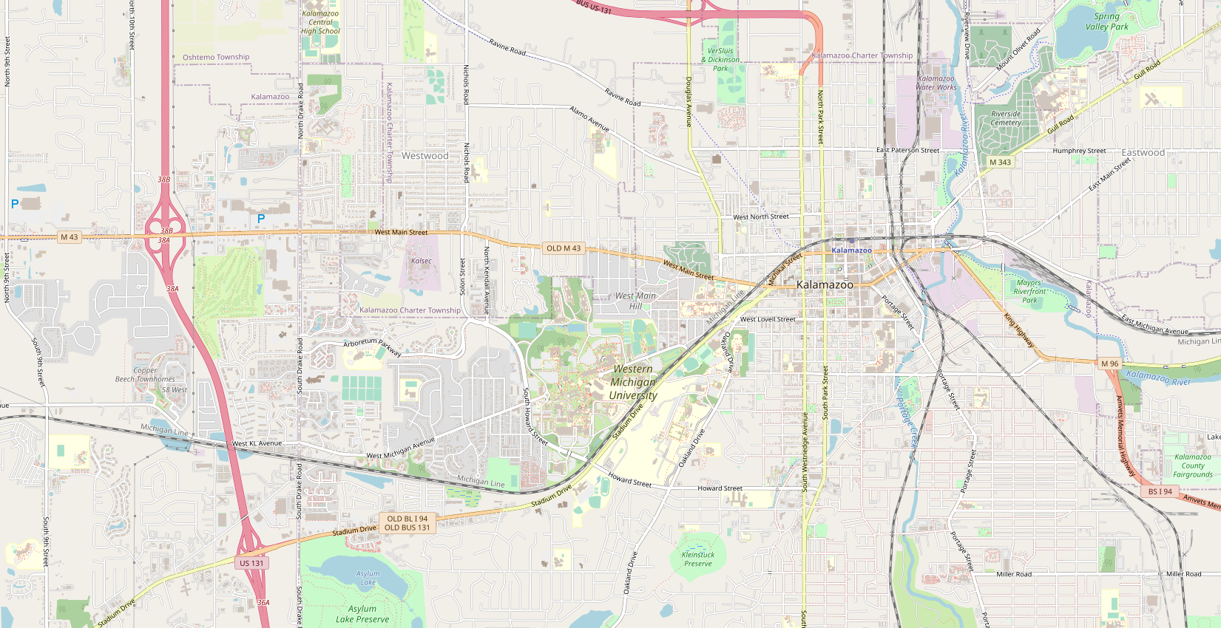
Overview oF GUI

Slide 3
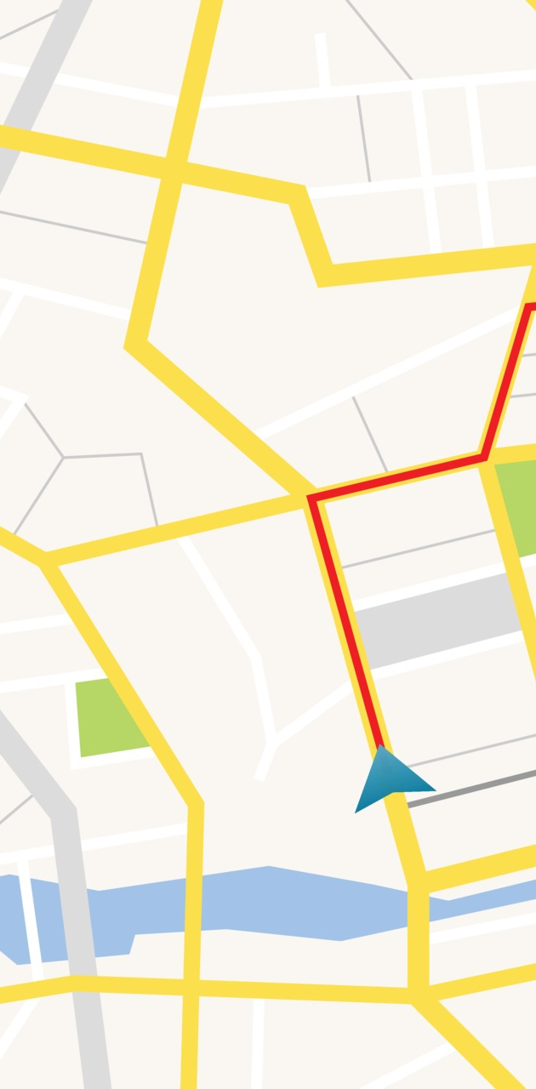
Website Overview
Fullscreen Map
Ability to add markers to the map, Max of 2
Menu Bar with many different settings that the user can enter or change.
Sliders and Buttons will be used to take in user input.
Menu Bar will also have help and about pop ups.
Layer button to change the map view from roads to satellite.

Slide 4
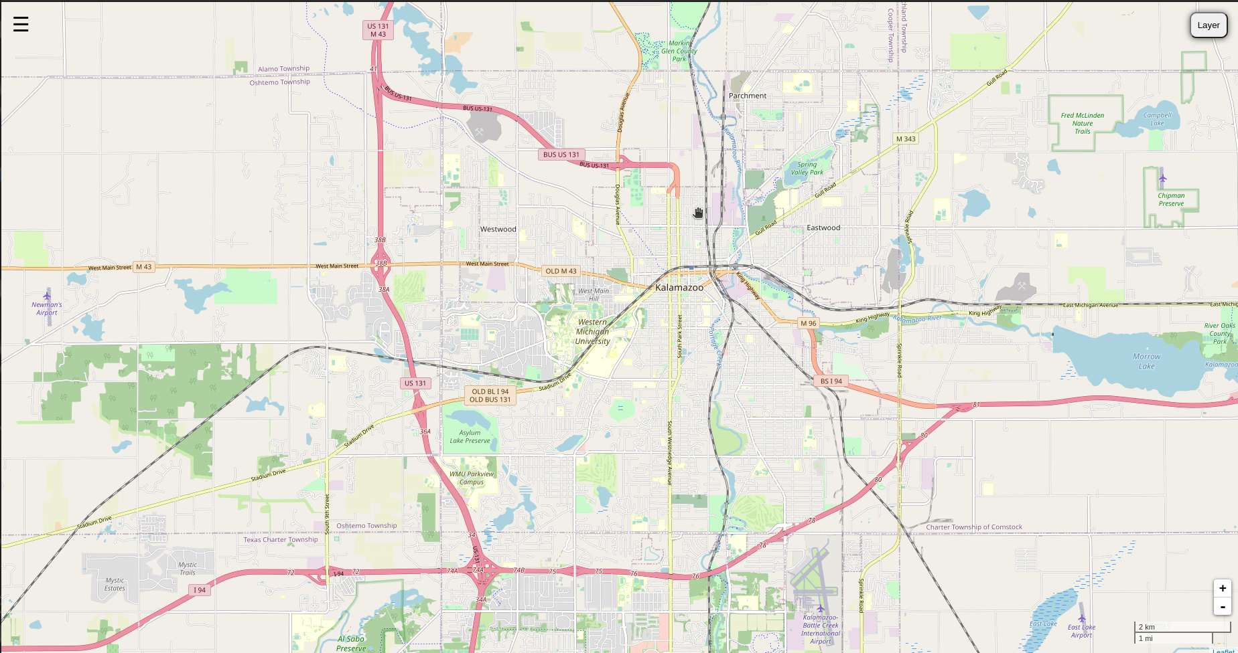
The overall website GUI

Slide 5
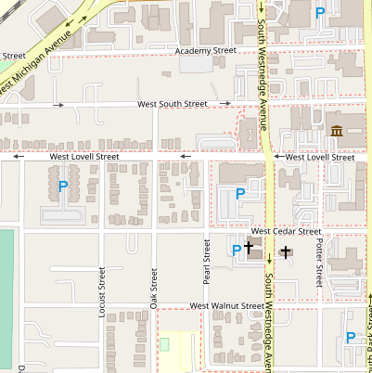
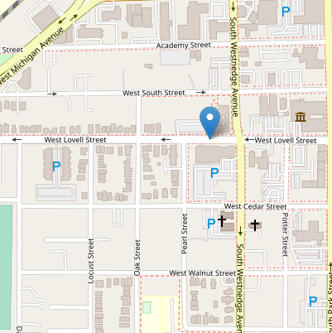
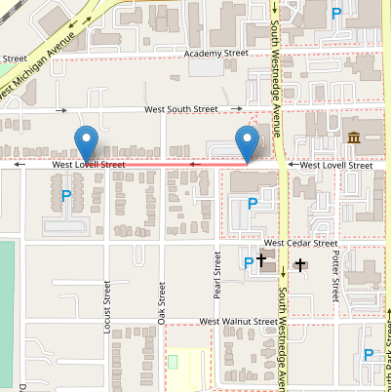
Users can place nodes and A line will be drawn between the nodes. By clicking on the map Nodes can be added and removed by clicking on them.

Slide 6
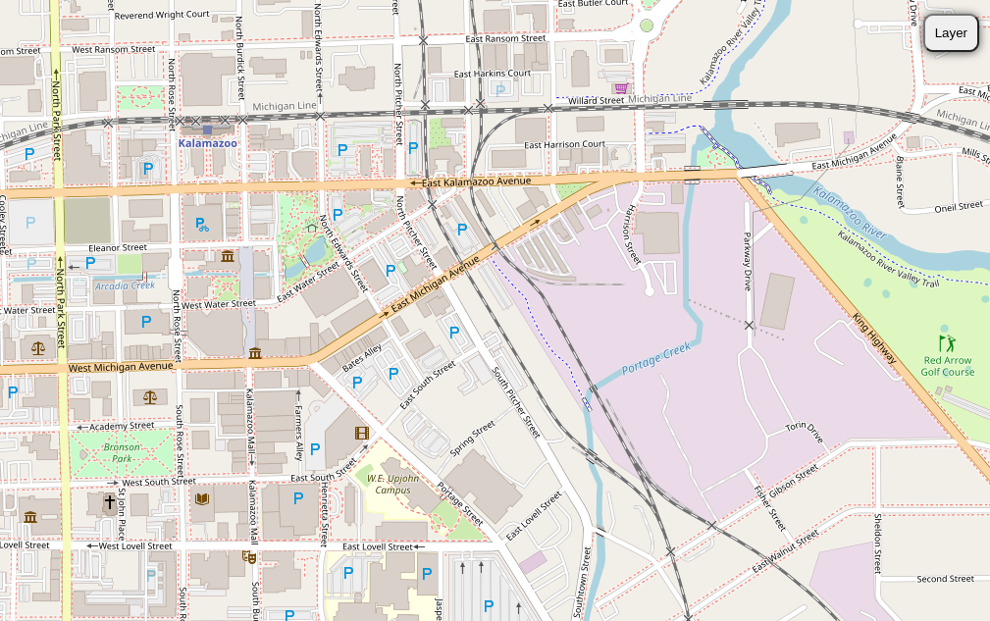
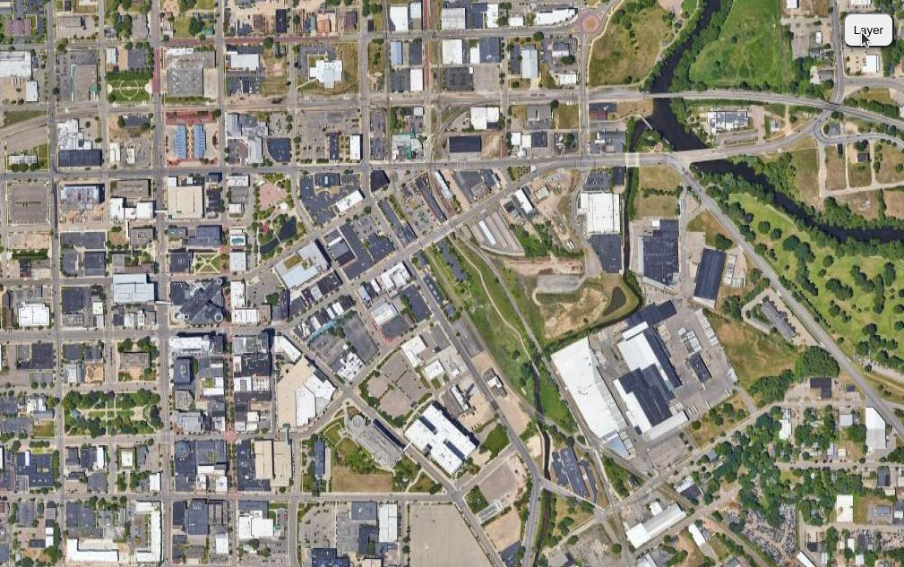


Can switch the map View with the layer button.

Slide 7
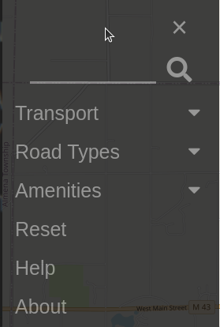
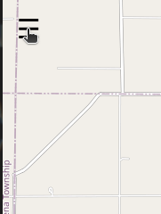
Settings Menu opens with a click of a button in the top left.

Slide 8
Transport Drop Down
The transport button will be an integrated dropdown with the menu. 4 options will be selectable.
Walking
Biking
Bus
Biking + Bus

Slide 9
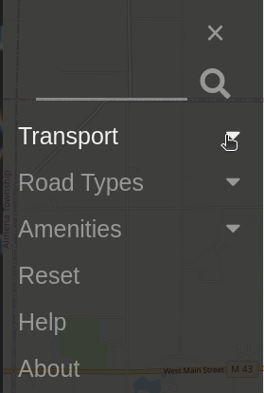
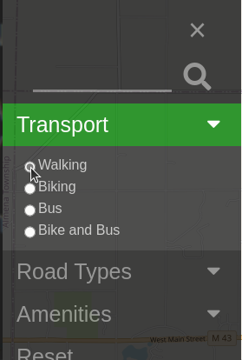


Slide 10
Road Types Drop Down
Road Types Drop down will provide the user with 4 sliders. Sliders will provide a weighted selection for user road preference.
Vehicle Speed Limit
Car Avoidance
Bike Lane Preference
Sidewalk Preference

Slide 11
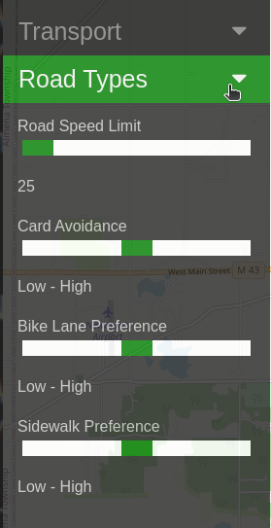
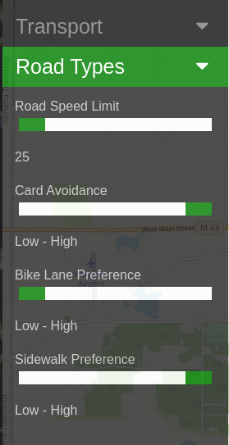
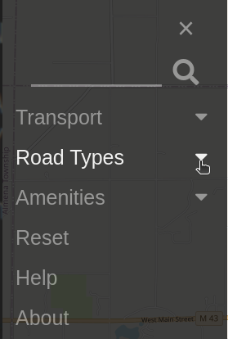
A person who's walking may want these settings.

Slide 12
Amenities Drop Down
Amenities Drop Down will provide different buttons to check that will then display the associated amenities.
Grocery Stores
Pharmacies
Bars and Restaurants
Etc...

Slide 13
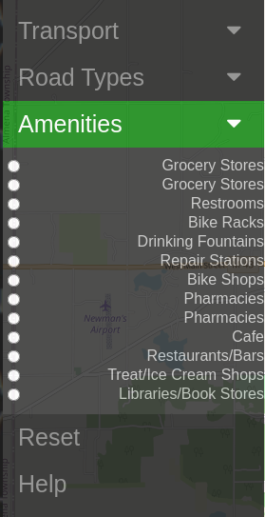
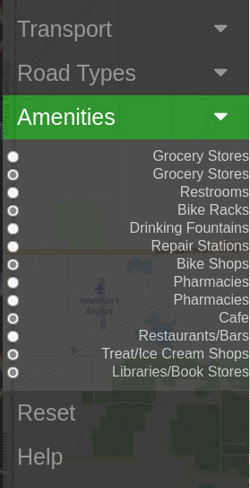

Slide 14
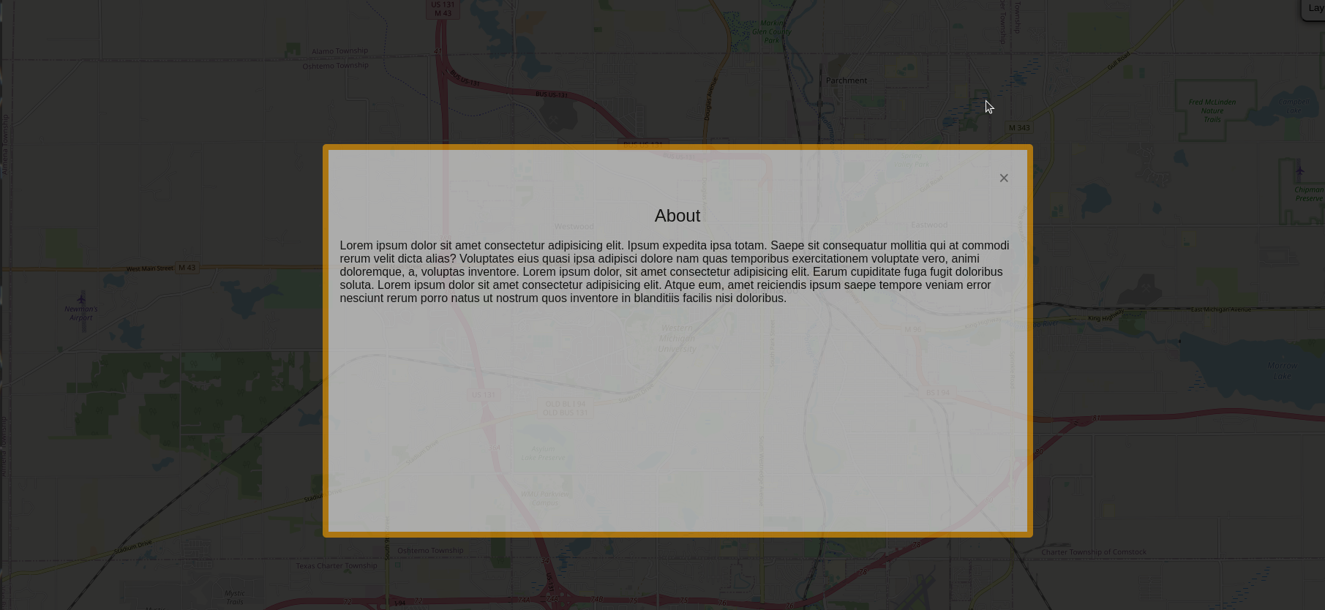

About and Help Pop ups

Slide 15
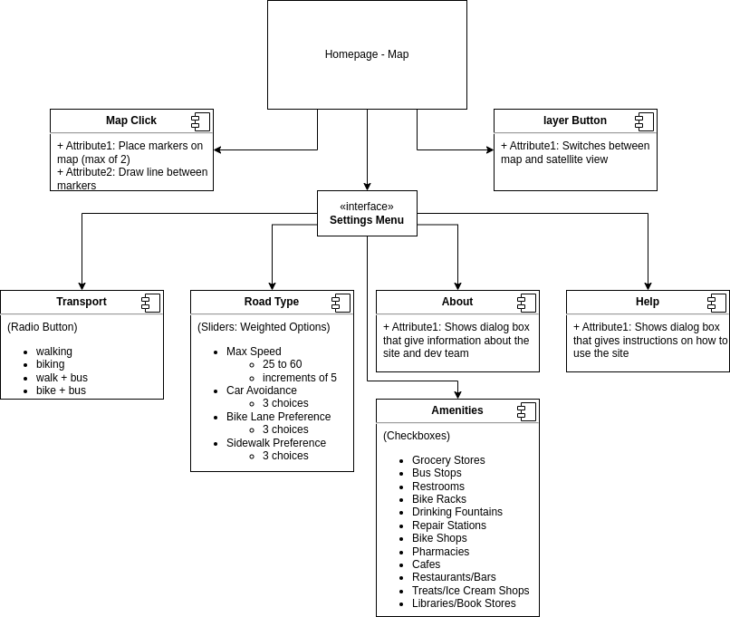
Website flow diagram

Slide 16
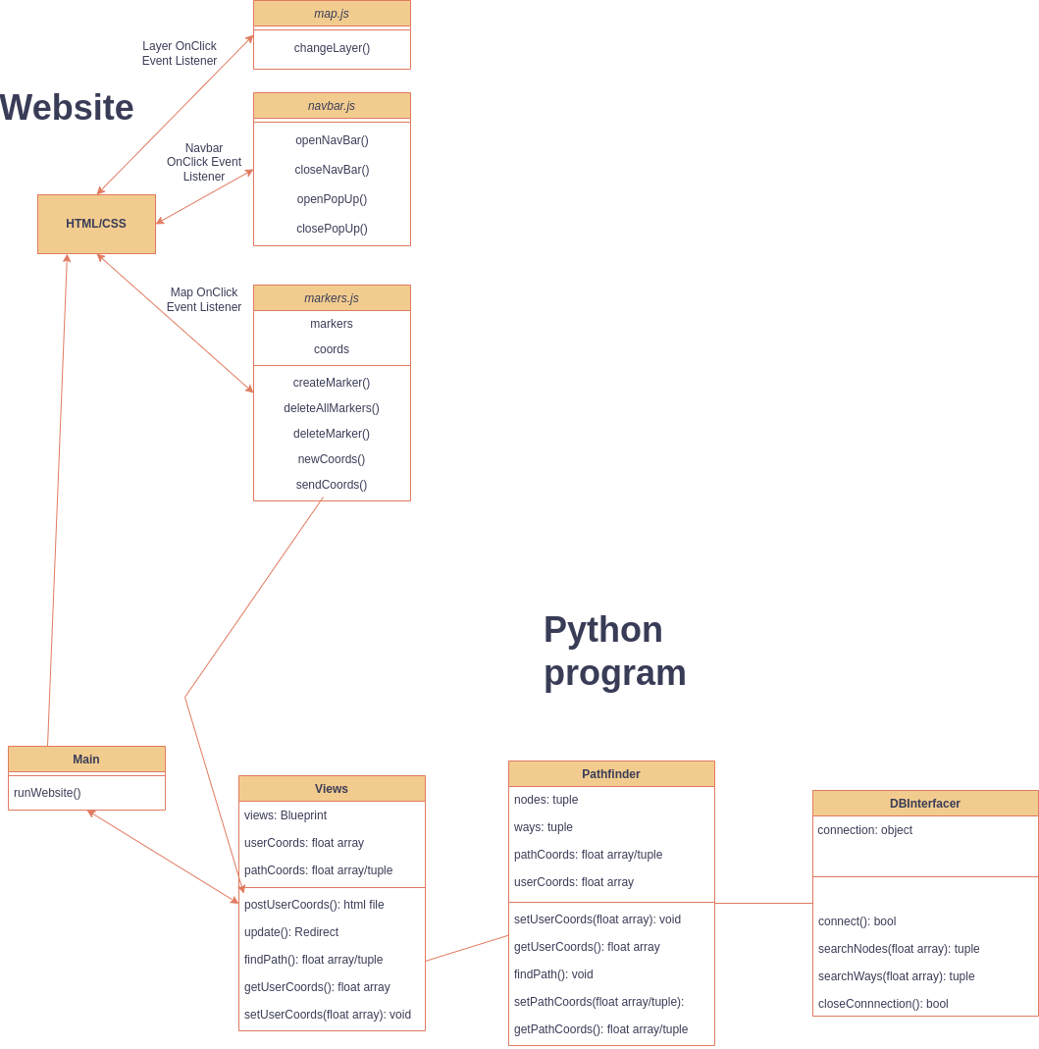
Class Diagram for backend More to come

Slide 17

Thank you
Any Questions?

